Slide 1
Analysis of Factors contributing to a High-Risk Pregnancy
An Exploratory Data Analysis
Oloyede, Olayemi Victoria
24th June, 2025

Slide 2
Introduction
High-risk pregnancies present significant challenges for maternal and infant health. Currently, Identification often occurs later in the gestation period, and thus limits quick intervention.
This Exploratory Data Analysis (EDA) aims to identify early demographic and medical factors that can indicate a high-risk pregnancy, ideally before 20 weeks.
The goal is to build a foundation for an early assessment system, which will enable quick and proactive identification, thereby allowing for a tailored care plan, especially in Primary Healthcare Centers (PHCs), to improve patient outcomes and optimize resource allocation.

Slide 3
Introduction (Cont.)
Objectives
To identify key factors associated with high-risk pregnancies.
To understand the distribution and relationship of these factors.
To inform potential interventions or further research
Data Source
Data is gotten from anonymized patient records of pregnant women, from a general hospital in Bangladesh, India, and it includes 1,205 patient records.

Slide 4
Dataset: Overview and Preprocessing
Description
Variables recorded and included in the dataset includes Patient’s demographic factors, clinical parameters, their medical history or pre-existing conditions, and the outcome variable which states whether the pregnancy is high-risk or low-risk. Overall, there are 5 categorical columns and 6 numerical variables.
Data Cleaning Steps
All Null values were removed, as they were only about 2% of the data
Invalid values, like Age=325 years and BMI < 6.7 were removed.
Outliers are clinically valid, and so were not dropped

Slide 5
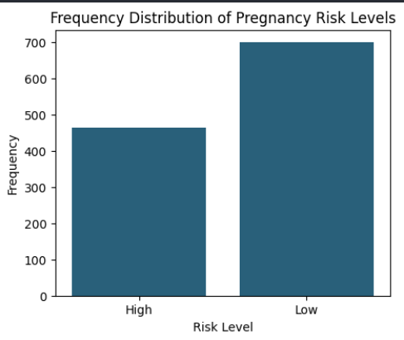
Target Variable
Findings
Data is imbalanced, almost int the ratio 6:4.
Most of the pregnant patients, had low-risk pregnancy
Although lower than the other group, there are still many patients with a pregnancy, classified as high-risk

Slide 6
Categorical Analysis

Slide 7
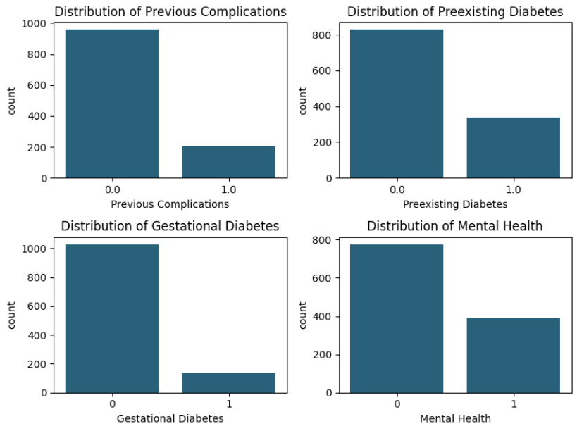
Univariate Analysis
Findings
In these charts, it should be noted that ‘0’ stands for ‘No’, and ‘1’ stands for ‘Yes’.
Those with the each of the conditions, i.e., previous complications, preexisting diabetes, gestational diabetes and mental health issues, are more than those who do not have.

Slide 8
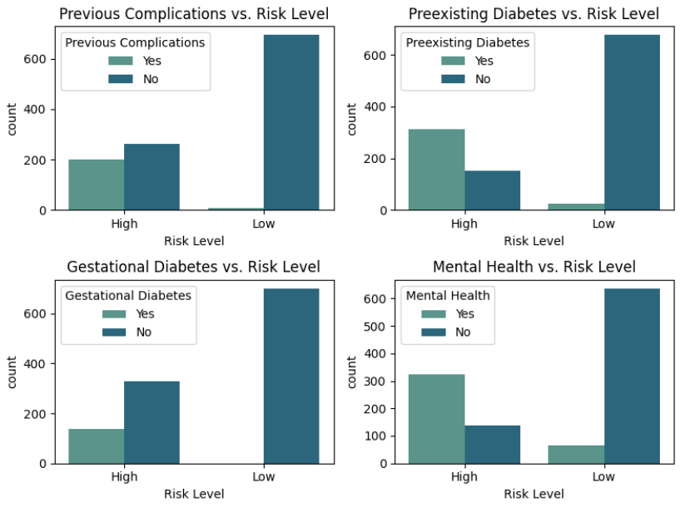
Health Conditions vs. Risk Level
Mental Health Issues and Preexisting Diabetes are significantly more prevalent in High-Risk pregnancies (70% and 67% respectively).
For Previous Complications and Gestational Diabetes, majority of the high-risk cases do not show a prior history of these conditions.
All analyzed conditions, consistently show a very low prevalence in Low-Risk pregnancies.

Slide 9
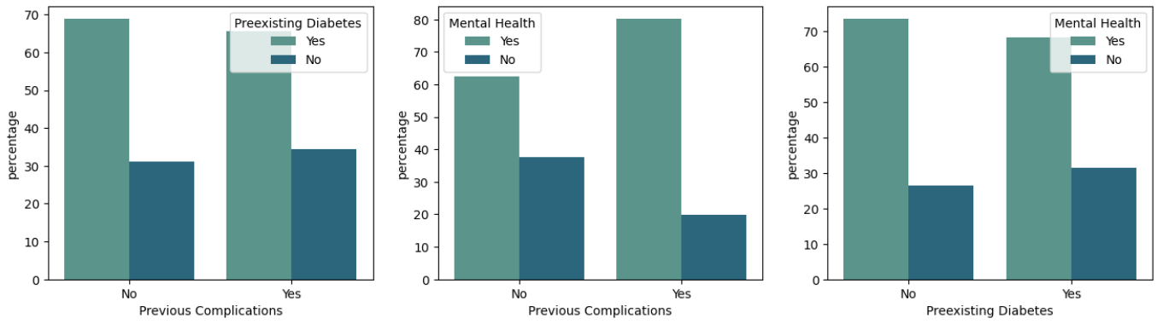
Health Conditions Comparison for High-Risk Pregnancies
Analysis reveals that mental health issues and preexisting diabetes are early indicators of a high-risk pregnancy.
Mental health challenges are extremely common, affecting 74% of those without pre-existing diabetes and 68% of those with it. Also, mental health issues are notably higher in those with previous complications (80%), than those who haven’t (62%).
Another insight gotten here is one that also shows preexisting diabetes to be a key factor, as it’s present in majority of high-risk cases without prior complications (70%) and in 67% of those recorded with it.
As we’re aiming for early risk assessment, gestational diabetes was removed, since it’s usually diagnosed after 20 weeks of gestation

Slide 10
Numerical Analysis

Slide 11
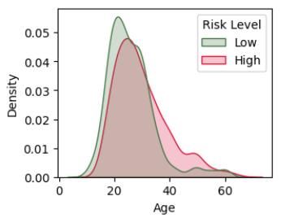
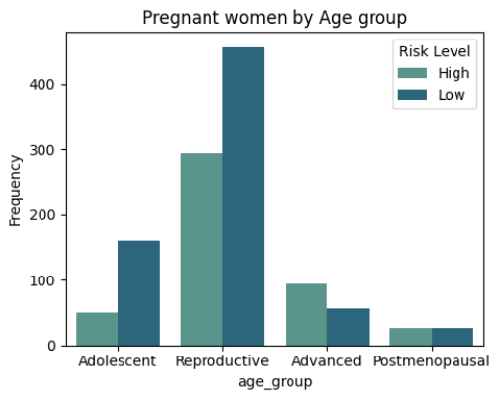
Age Analysis
Age Distribution:
The KDE plot here, shows that although high-risk pregnancies are more common overall, high-risk pregnancies become more dominant from around the age 35 onward
Age Analysis:
To further analyze this, the Age values were grouped, based on medical guidelines, into Adolescence (<20), Early reproductive age (20-34 years), Advanced Maternal age (35-49 years), and Postmenopausal age (50+ years)
It could be seen, that for Adolescent and Reproductive ages, which is up to 34years, there are more low-risk pregnancies than high-risk ones, but from the advanced age onward, there are more high-risk pregnancies, further establishing what was seen in the KDE plot.

Slide 12
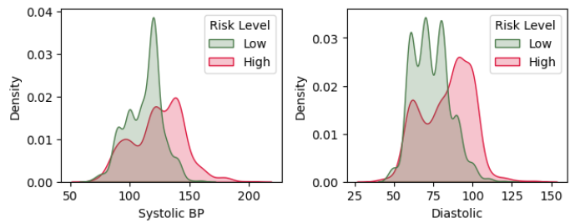
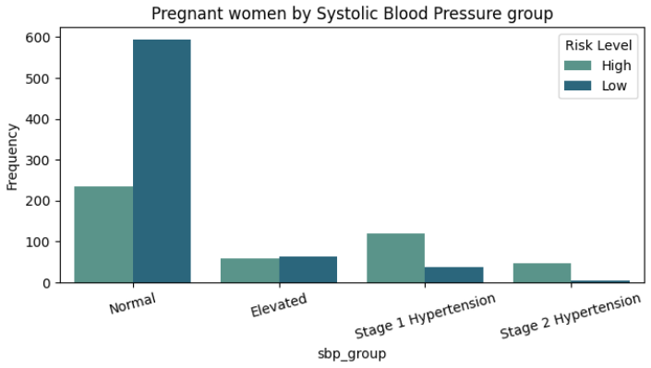
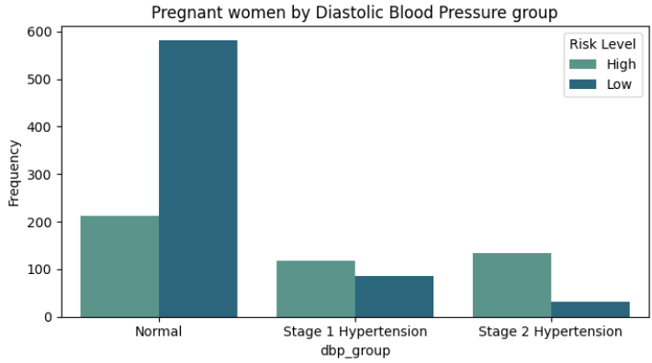
Blood Pressure Analysis
Distribution:
The KDE plots show the density of high-risk pregnancies become dominant at Systolic BP of around 130mmhg and Diastolic BP of about 80mmhg.
Analysis:
To further analyze the observations from the KDE plots, these were grouped and we can see high-risk pregnancies increase from BP(130/80 mmhg).

Slide 13
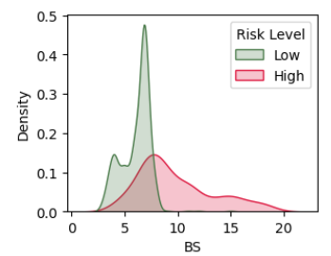
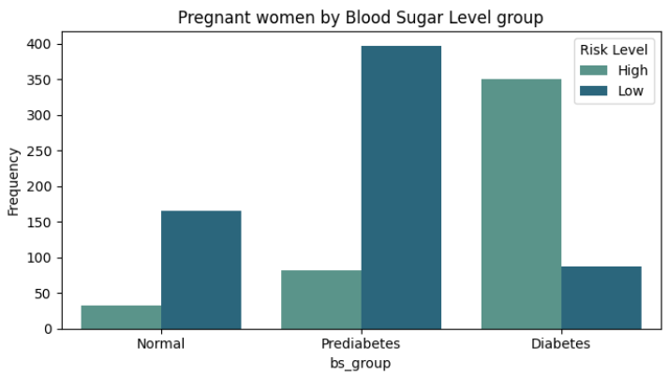
Blood Sugar Level Analysis
It can be seen, that most high-risk pregnancies are clustered at around blood sugar level 7mmol/L and they became more dominant from there on.
This can also be seen in the grouped chart, that more of the diabetic patients have high-risk pregnancies and it also confirms diabetes as a key factor that contributes to a pregnancy being high-risk.

Slide 14
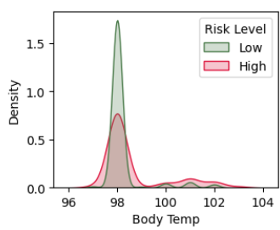
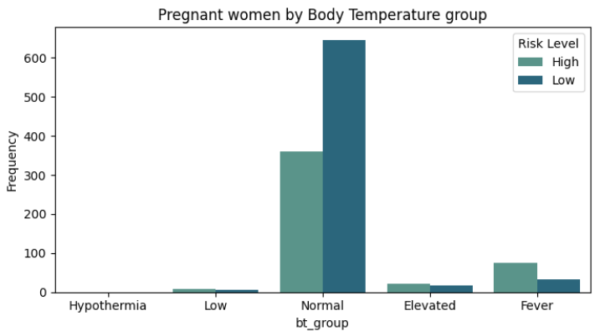
Analysis Based on Body Temperature
Now, body temperature is very important during pregnancy, as a temperature higher than 99.5°F (37.5°C), could indicate an infection. Here, it can be seen that most of our pregnant women have normal body temperatures of around 98°F (36.7°C), with only a few patients having a temperature of 100°F (37.8°C).
Truly, it can be seen that for those, who have higher than normal temperatures, there are more high-risk pregnancies.

Slide 15
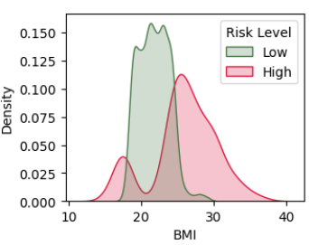
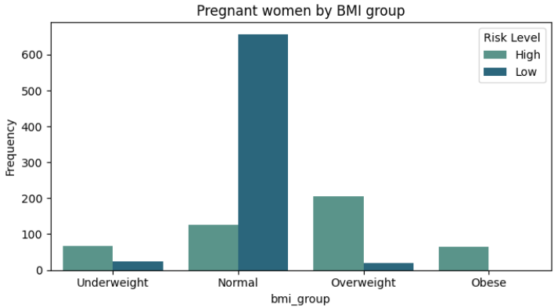
BMI Analysis
An healthy Body Mass Index (BMI) will generally, improve the outcome of a pregnancy. Looking at our data, low-risk pregnancies are generally clustered around the normal range of 18.5 – 24.5.
Now, taking a look at the high-risk pregnancies, we can see a multi-modal distribution, i.e., our high-risk pregnant women are majorly underweight and overweight.
This is also confirmed in the groupings, where high-risk pregnant women are mostly in Underweight, Overweight and Obese classes.

Slide 16
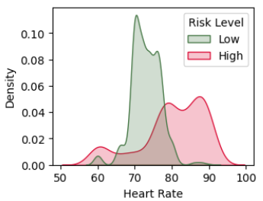
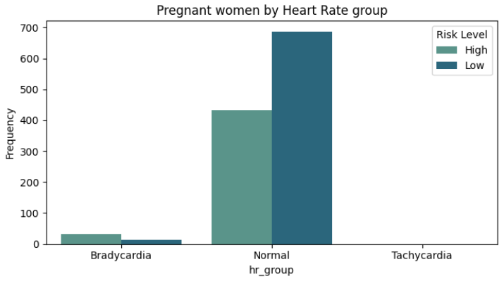
Heart Rate vs. Pregnancy Risk
During pregnancy, a resting heart rate not in the range of 60-100 beats per minute (bpm), is usually considered abnormal.
Most of the pregnant women have a normal heart rate, with few having less than 60bpm(Bradycardia).
While it makes sense from the bar chart, that patients with bradycardia have more high risk pregnancies, the curve shows that most high-risk pregnant women have heart rates from 80% onward.

Slide 17
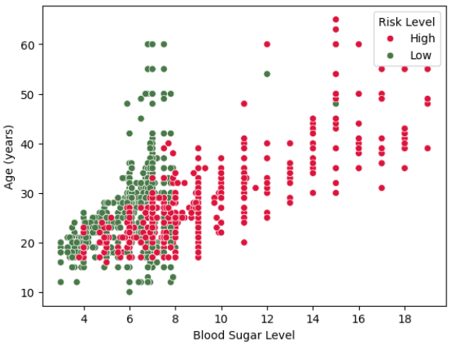
An Interesting Relationship: Age and Blood Sugar
While checking for relationships between the variables, one caught my attention, and that the relationship between age and blood sugar levels, especially for high-risk pregnancies. The Pearson's correlation between both variables, also shows a strong correlation (0.79), just for high-risk pregnancies.
This ultimately shows that for high-risk pregnant women, the older they are, their possibility of having a higher blood sugar level is high

Slide 18
Conclusion
Several Factors contribute to a pregnancy, being high-risk. They include;
Pre-existing diabetes and mental health issues are primary early indicators for an high-risk pregnancy
High blood Sugar and Older age, are also very important indicators
Other factors contributing to high-risk pregnancies include Elevated Blood Pressure, Abnormal BMI, Elevated blood pressure and certain heart rate patterns

Slide 19
Recommendations
Leveraging the data already collected, a system that flags pregnant individuals, presenting with these conditions, early on in their gestation, as high-risk, should be developed.
Data collection should be extended, to include other factors such as Parity, Lifestyle factors, medical history, etc., so as to provide more understanding of each risk profile.

